Slide 1
NAME : LOKESH.S.B III rd YEAR BE COMPUTER SCIENCE REG NO.-211521104081

Slide 2
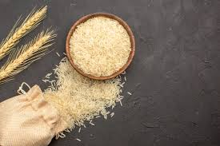
TNSDC-Generative AI
RICE GRAIN QUALITY ANALYSIS USING CNN

Slide 3
AGENDA
PROBLEM STATEMENT
PROJECT OVERVIEW
WHO ARE END USERS?
SOLUTION AND ITS VALUR PROPORTIONS
MODELLING
RESULTS
CONCLUSION

Slide 4
PROBLEM STATEMENT
Rice is a staple food crop for millions of people worldwide, and the quality of the rice grains is a critical factor in determining its market value and consumer acceptance. Traditional methods of grading and classifying rice grains are time-consuming and subjective, leading to inconsistencies and errors in the final product. In recent years, deep learning (DL) techniques have shown great promise in automating the process of rice grain quality analysis. In this study, we developed a DL-based approach for rice grain quality analysis using a large dataset of rice grain images. The DL model was trained to classify rice grains based on various quality parameters such as size, shape, colour, texture, and defects. The results showed that the DL model could accurately classify rice grains with a high degree. Furthermore, the DL-based analysis provided insights into the underlying physical and chemical properties of the rice grains, which can be used to optimize production and processing methods.

Slide 5
PROJECT OVERVIEW
Rice is one of the most important staple crops in the world, providing a significant source of nutrition for billions of people. The quality of rice grains is crucial for ensuring food security and economic development. Traditional methods of rice quality analysis are time-consuming, labour-intensive, and subjective, involving visual inspection by human experts. This can lead to inconsistencies in quality assessment, which can have significant economic consequences for farmers, processors, and consumers. In recent years, deep learning (DL) has emerged as a promising tool for automated and objective quality analysis of agricultural products, including rice grains. DL is a subfield of machine learning that involves training artificial neural networks on large datasets to learn patterns and features that can be used to classify, segment, or detect objects in images or other data types. DL-based approaches for rice grain quality analysis can provide a more accurate, efficient, and objective method for grading and classifying rice grains based on various quality parameters such as size, shape, colour, texture, and defects. This can help farmers and processors to optimize their production and processing methods, reduce waste, and ensure consistent quality of the final product. Additionally, DL-based quality analysis can also provide insights into the underlying physical and chemical properties of rice grains, which can further inform improvements in the rice production and processing industry. In this study, we present a DL-based approach for rice grain quality analysis, which involves training convolutional neural networks (CNNs) on a large dataset of rice grain images to classify and grade grains based on various quality parameters. We demonstrate the effectiveness of our approach through extensive experiments on real-world datasets, showing that DL-based approaches can achieve high accuracy and performance for rice grain quality analysis. The results of this study have important implications for the rice production and processing industry, as well as for the broader field of agricultural quality analysis using DL.In this study, we present a DL-based approach for rice grain quality analysis, which involves training convolutional neural networks (CNNs) on a large dataset of rice grain images to classify and grade grains based on various quality parameters. We demonstrate the effectiveness of our approach through extensive experiments on real-world datasets, showing that DL-based approaches can achieve high accuracy and performance for rice grain quality analysis. The results of this study have important implications for the rice production and processing industry, as well as for the broader field of agricultural quality analysis using DL.

Slide 6
WHO ARE THE END USERS?
End users of grain quality prediction using AI can vary depending on the specific application and context. Here are some potential end users:
Farmers: Farmers can utilize grain quality prediction systems to optimize their farming practices, including planting, harvesting, and storage, based on predicted grain quality. This can help them maximize yields and profits.
Grain Elevators and Processors: Companies involved in grain storage, handling, and processing can benefit from AI-powered grain quality prediction systems to optimize their operations, manage inventory, and ensure consistent product quality.
Food Manufacturers: Food companies that use grains as ingredients in their products can use AI-based grain quality prediction to ensure the quality and consistency of their raw materials, leading to better final products.
Traders and Distributors: Traders and distributors in the agricultural commodities market can use grain quality prediction to make informed decisions about buying, selling, and transporting grains based on their predicted quality and value.
Researchers and Academia: Researchers and academia can use AI-driven grain quality prediction models to study trends in grain quality, develop new algorithms, and advance the field of agricultural science.
Government Agencies: Agricultural departments and regulatory agencies can utilize grain quality prediction systems to monitor and regulate grain quality standards, ensure food safety, and support policy-making decisions.
Consumers: Ultimately, consumers can indirectly benefit from AI-driven grain quality prediction by having access to consistently high-quality grain-based products on the market.

Slide 7
YOUR SOLUTION AND ITS VALUE PROPOSITION
In proposed system using a Dense net model for rice quality analysis can provide an accurate and efficient way to classify different types of rice based on their quality. This system can be used by rice producers, processors, and consumers to ensure consistent quality and make informed decisions about rice selection.
A system for rice grain quality analysis using Resnet could provide a fast and accurate way to classify rice grains based on their quality, which could help rice mills and agricultural research institutes make more informed decisions.

Slide 8
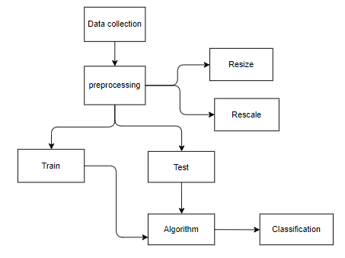

Slide 9
modelling
INPUT DESIGN
In an information system, input is the raw data that is processed to produce output. During the input design, the developers must consider the input devices such as PC, MICR, OMR, etc.
Therefore, the quality of system input determines the quality of system output. Well-designed input forms and screens have following properties −
Objectives for Input Design:
The objectives of input design are −
• To design data entry and input procedures
• To reduce input volume
• To design source documents for data capture or devise other data capture methods
• To design input data records, data entry screens, user interface screens, etc.
• To use validation checks and develop effective input controls.

Slide 10
OUTPUT DESIGN
The design of output is the most important task of any system. During output design, developers identify the type of outputs needed, and consider the necessary output controls and prototype report layouts.
Objectives of Output Design:
The objectives of input design are:
• To develop output design that serves the intended purpose and eliminates the production of unwanted output.
• To develop the output design that meets the end user’s requirements.
• To deliver the appropriate quantity of output.
• To form the output in appropriate format and direct it to the right person.
• To make the output available on time for making good decisions.

Slide 11
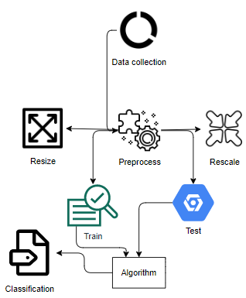
ARCHITECTURE

Slide 12
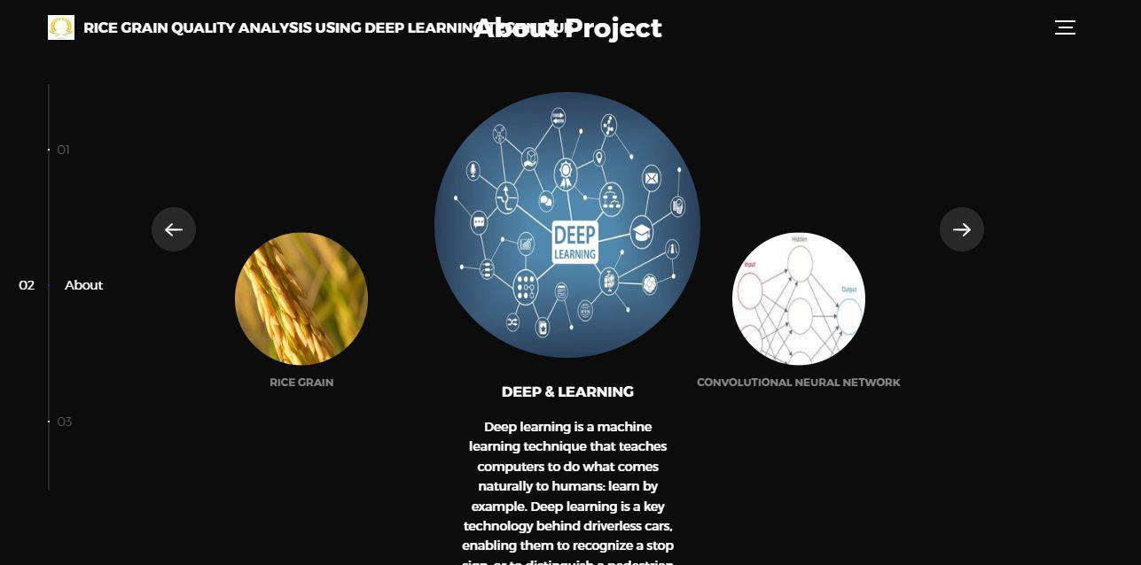
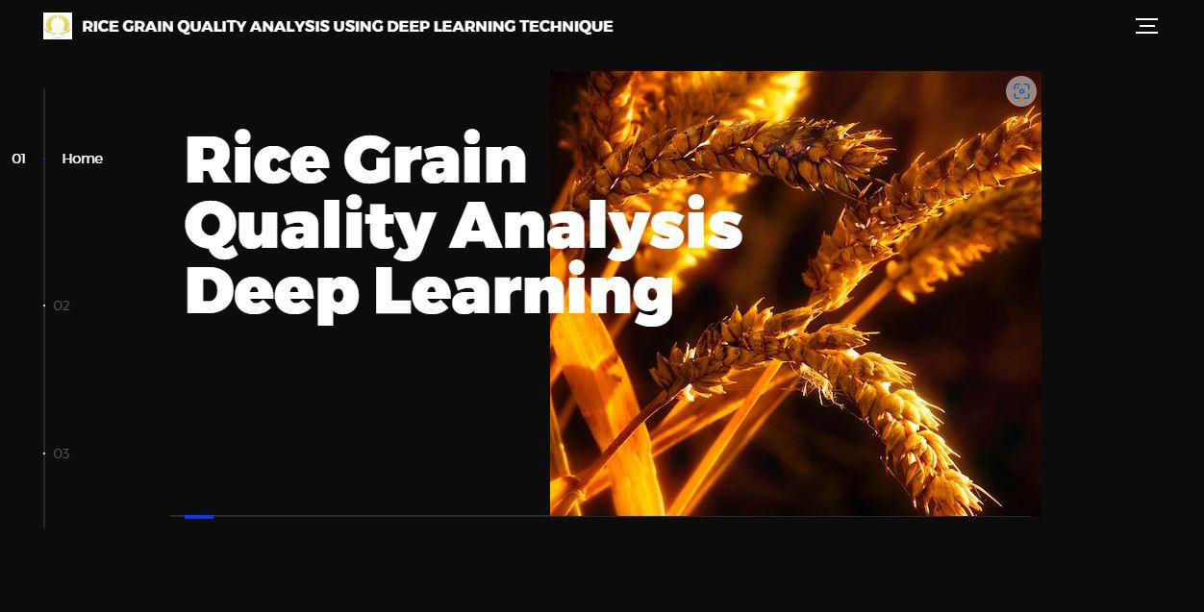
output
About
Home

Slide 13
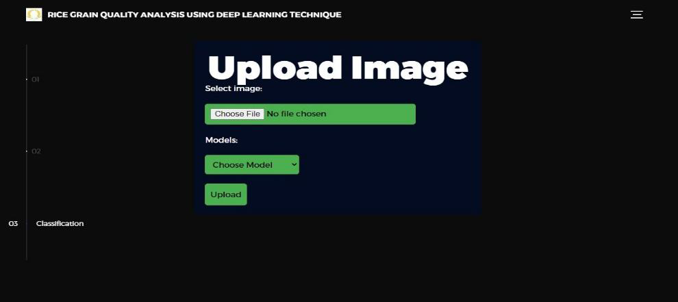
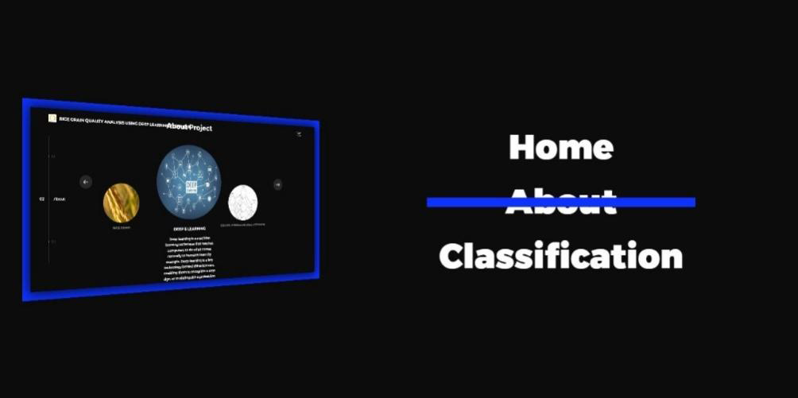
Image upload
Mode

Slide 14

Model selection

Slide 15
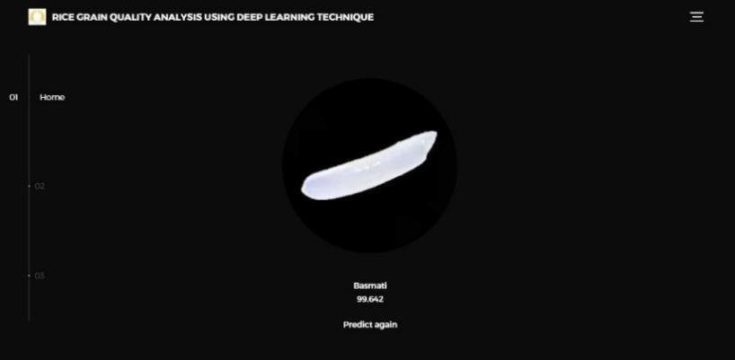

RESULTS
Result 1
Result 2

Slide 16
CONCLUSION
The use of deep learning techniques, such as convolutional neural networks (CNN), Dense net and Mobile net, have shown promising results in the analysis of rice grain quality. These techniques have been used to detect and classify various parameters, such as the presence of disease, grain size, and shape, which are crucial for determining the quality of rice. The analysis of rice grain quality using deep learning techniques offers several advantages over traditional methods, including higher accuracy, faster analysis, and the ability to analyse a large number of samples simultaneously. This can be especially beneficial for rice breeding programs, where the analysis of a large number of rice samples is necessary to identify desirable traits.

Slide 17
REFERENCES
[1] Huang, M., Wang, Z., Lv, H., Jiang, Q., & Huang, D. (2021). Deep Learning Techniques for Rice Quality Evaluation: A Review. Journal of Agricultural and Food Chemistry, 69(5), 1441-1453.
[2] Xu, Y., Zhang, S., & Wang, X. (2019). A rice quality detection method based on deep learning. IEEE Access, 7, 131189-131199.
[3] Zhang, H., Wang, C., & Zhao, X. (2019). Identification of rice seed varieties using a deep convolutional neural network. PloS one, 14(10), e0223588.
[4] Li, D., Li, X., Shi, Y., & Chen, Y. (2020). Identification of rice seed quality based on deep learning technology. Scientific reports, 10(1), 1-8.
[5] Liu, H., Chen, L., Zhang, Y., & Huang, Y. (2020). Study on deep learning application in rice quality detection. In 2020 IEEE 9th International Conference on Advanced Logistics and Transport (ICALT) (pp. 186-191). IEEE.
[6] Zhang, H., Wang, C., & Zhao, X. (2019). Deep learning-based method for identifying rice seed varieties using seed images. Computers and Electronics in Agriculture, 165, 104995.
[7] Xie, S., Zhao, L., Zhang, Y., & Zhang, J. (2020). Deep Learning-Based Rice Seed Quality Inspection Using Multi-Feature Fusion. IEEE Access, 8, 220622-220632.
[8] Liu, Y., Zhu, H., Zhou, Y., Wu, G., & Chen, W. (2019). Identification of rice quality by deep learning. Journal of Food Science and Technology, 56(10), 4798-4805.
[9] He, Z., Zhou, J., & Zhang, X. (2020). A deep learning approach for assessing the quality of milled rice based on image analysis. Computers and Electronics in Agriculture, 178, 105731.

